Slide 1
Atmospheric transport modelling concepts Source oriented / receptor oriented approaches
Questions? Write delia.arnold-arias@zamg.ac.at
Notes:
1
1

Slide 2
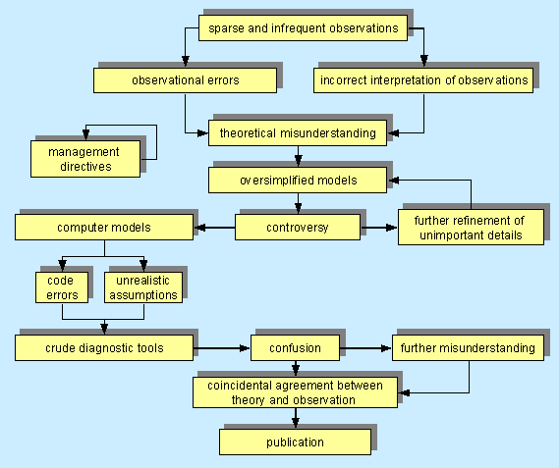
ATM background
All about computer modelling … http://biocycle.atmos.colostate.edu/~marek/research/mod.htm
“All models are wrong but some are useful” G.E.P. Box Robustness in the Strategy of Scientific Model Building … and continues “For such a model there is no need to ask the question "Is the model true?". If "truth" is to be the "whole truth" the answer must be "No". The only question of interest is "Is the model illuminating and useful?".
Notes:
2
2

Slide 3
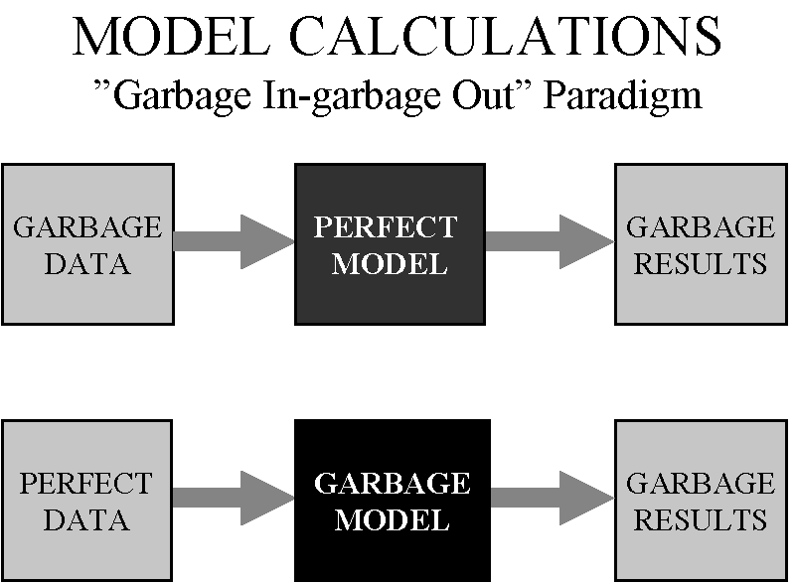
ATM background
https://www.cfact.org/2017/02/27/gigo-based-energy-and-climate-policies/
Neither perfect model nor perfect data exist.
Notes:
3
3

Slide 4
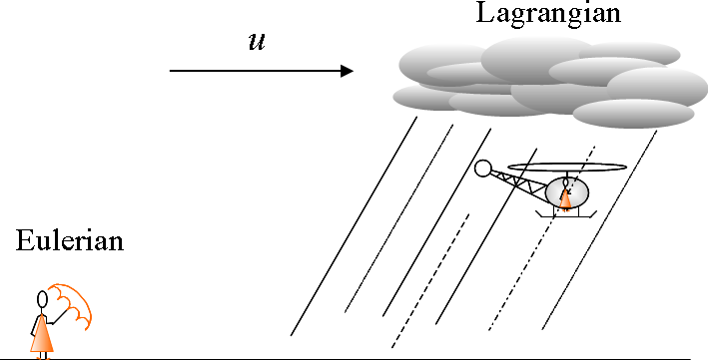
ATM background
Two basic types of reference frames to model atmospheric flows:
Fixed gridded system
Following an air parcel
Notes:
4
4

Slide 5
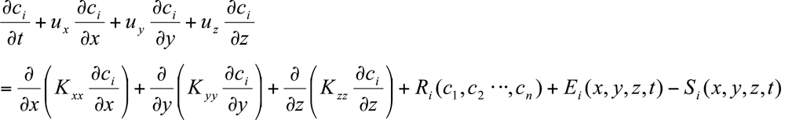
ATM background
Eulerian
Lagrangian
Trajectories consistent with pre-defined Eulerian probability functions in physical and velocity space – trajectory differential equation
·
Divergence of the advected flux
5
Chemical reactions
Sinks
Divergence of the turbulent fluxes
Emissions
Notes:
5
5

Slide 6
ATM background
Eulerian
Lagrangian
·
Immediate dilution in the grid cell
Point source sub-model then needed
LPDM can deal naturally with point sources
The grid is only applied to output fields
October 2012
Notes:
6
6

Slide 7
ATM background
Eulerian
Lagrangian
v
Problems with representing narrow plumes
Notes:
7
7

Slide 8
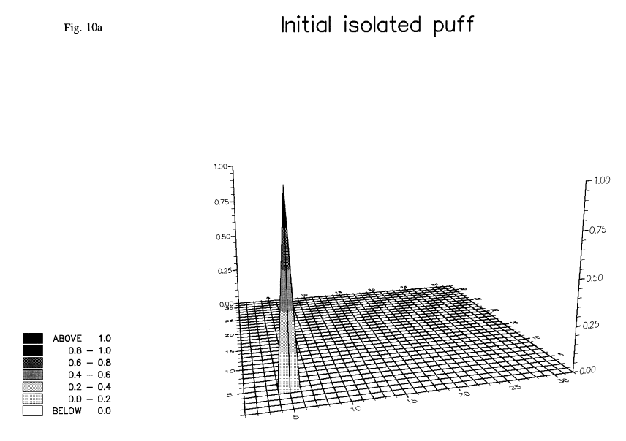
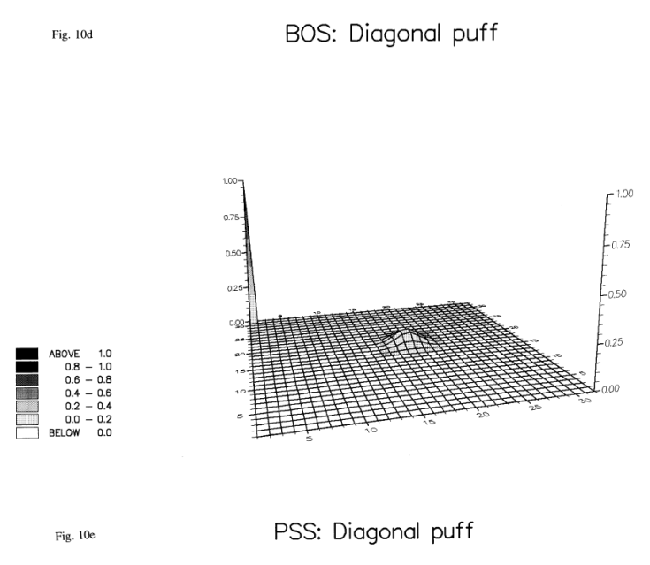
ATM background
Eulerian
Lagrangian
/MSC-W Note 2/92, August 1992.EMEP "An Evaluation of Eulerian Advection Methods for the Modelling of Long Range Transport of Air Pollution". By Erik Berge and Leonor Tarrasón. EMEP_1992_N2.pdf
u1
u2
u?
u4
u3
Interpolation errors (of all variables to particle position) and discretization of differential equations
Numerical diffusion in the advection
Notes:
8
8

Slide 9
Why Lagrangian?
Can be computationally very efficient (depending on size of plume): only the fraction covered with particles is simulated. Computational cost depending on particle numbers BUT LPDM are easily parallelized.
Turbulent processes are included in a more natural way unlike Eulerian models
Capacity to describing non-diffusive near-field to sources.
There is no numerical diffusion due to a computational grid
Grid and/or kernels are used only for output purpose therefore no artificial diffusion is due to the averaging process
Model is “self-adjoint” – can run backward in time, too. Important for RO modelling
Many first order processes can be easily included with a prescribed rate: radioactive decay, dry deposition, washout, etc.
One particle can carry more than one species
Gravitational settling is easily included (as long as particles carry a single species)
However: it is quite difficult and computationally expensive to include non-linear chemical reactions and the process of gridding the output make as well loose some of the advantages of Lagrangian modelling.
Notes:
9
9

Slide 10
Main types of Lagrangian models
Mean Trajectories – it assumes that the air parcel does not have the identity modified and that one single line represents its motion defined solely by the mean wind.
No diffusion is considered
No turbulence is considered
Very simple, very fast and visually appealing (by some)
More valid for laminar or little turbulent flows such in the stratosphere
Box models – a box that stretches or compresses along a trajectory defined, once more, by the mean wind. The box may be re-presented by one or more trajectories.
No diffusion is considered
No turbulence is considered
Good for chemistry
Strong wind shear deforms the boxes
Notes:
10
10

Slide 11
Main types of Lagrangian models
Gaussian Puff model – it uses puffs moving along with the mean wind and with puffs growing in size (usually following a Gaussian) according to turbulence.
Good for constant winds and turbulence
Problems in strong wind shears
Handling merging of puffs
Lagrangian particle dispersion models (LPDM) – particles are released with a certain amount of mass and species and are moved by the mean wind but also by turbulent contributions to the velocity.
Particles follow the eddies and are not “deformed”
Many particles are needed to properly represent a plume (more computational costs than previous models)
Possibility to treat heterogeneous turbulence
Notes:
11
11

Slide 12
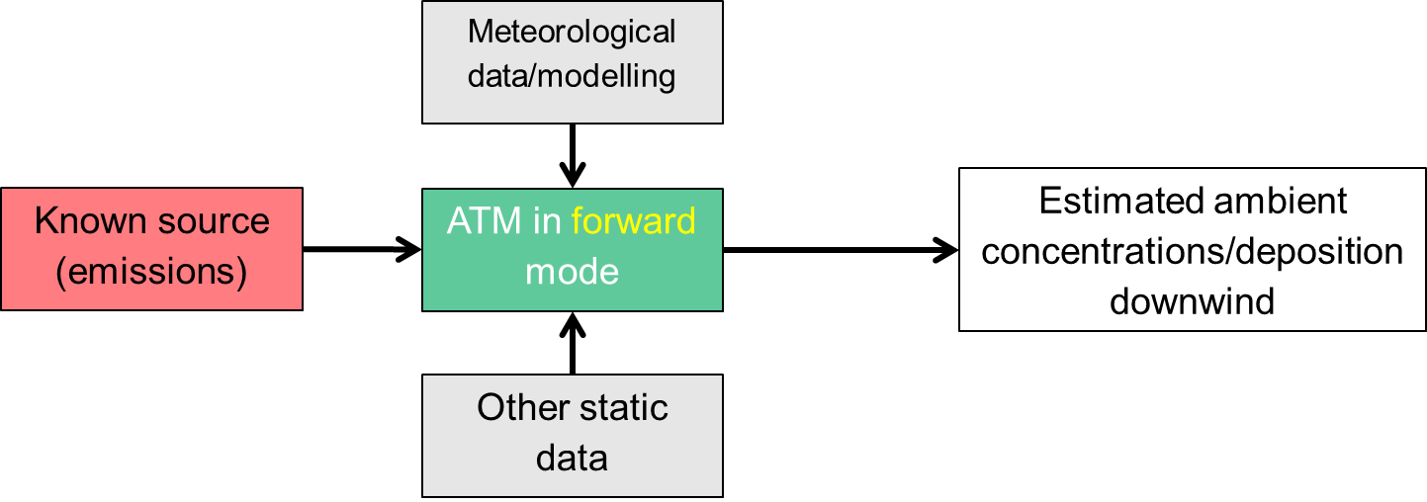
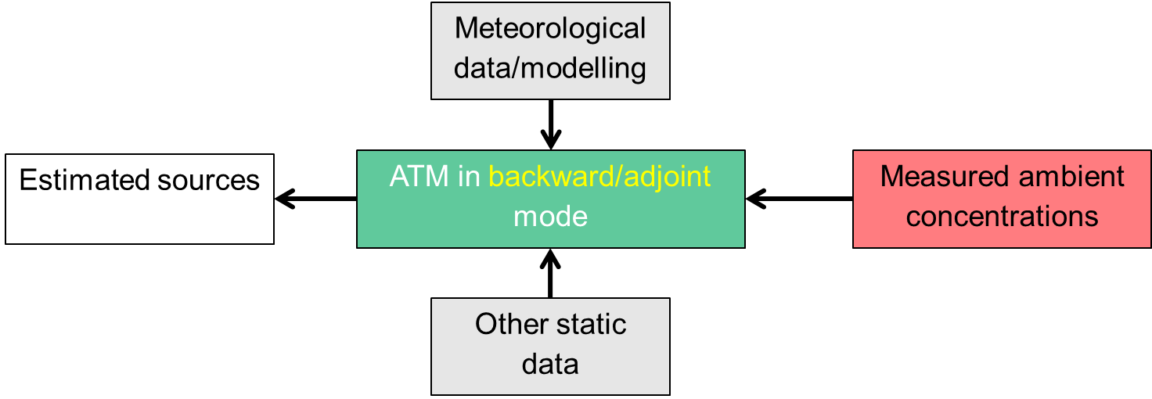
SO ATM / RO ATM
Source (emission) oriented ATM aims at estimating the concentrations downwind given a known emission (location, time, strength, type).
Receptor (measurement) oriented ATM aims at using physical and chemical measurements to infer some knowledge on the potential/probable sources and usually quantify their contributions (source attribution, source apportionment).
Notes:
12
12

Slide 13
SO ATM / RO ATM
Source (emission) oriented ATM aims at estimating the concentrations downwind given a known emission (location, time, strength, type).
SO
Receptor (measurement) oriented ATM aims at using physical and chemical measurements to infer some knowledge on the potential/probable sources and usually quantify their contributions (source attribution, source apportionment).
RO
backtracking
Notes:
13
13

Slide 14
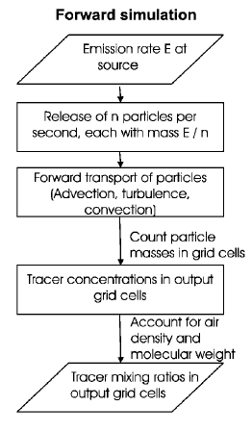
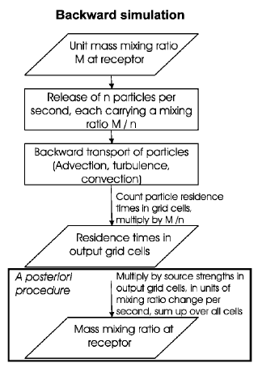
SO ATM / RO ATM
Once the residence times (model sensitivities, source receptor sensitivities) are obtained, additional processing to get estimates
Notes:
14
14

Slide 15
SO ATM / RO ATM - fwd/bwd calculations
From Lin (“Lagrangian Modeling of the Atmosphere: An Introduction”, 2012), examples of questions that can be addressed by fwd vs bwd Lagrangian simulations:
Forward | Backward
Where does the air go? | Where does the air come from?
What is the downwind impact of a source? | What are the upwind influences on the receptor?
Where do tracers get transported? | Where are the source regions of tracers?
How much is the concentration of the tracer at downwind locations affected by a unit emission of the source? | How strong is the sensitivity of the receptor to a particular upwind source region? ** this can be done either fwd or bwd, bwd is more efficient
Notes:
15
15

Slide 16
important concept: SRS
SRS definition
Definition – SRS Source Receptor Sensitivity
A Source Receptor Sensitivity Field is a 3-dimensional (2 spatial, 1 temporal) array M pertaining to one single measurement k, providing a multiplication factor [m⁻³] which translates each element of a source cell at position (i,j) and time step t (duration: Δt) in a resulting concentration value c [kgm⁻³/Bqm⁻³]:
M are the SRS fields or also called model sensitivities or Transfer Coefficient Matrices (TCM) – these are obtained by the atmospheric transport model calculations – either forward or backward (often more efficient)
Notes:
16
16

Slide 17


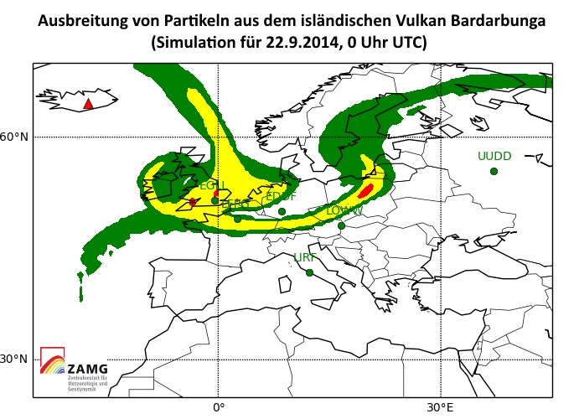
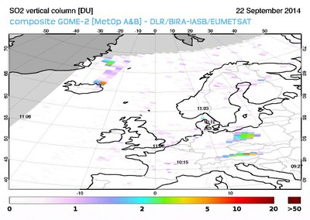
SO ATM - Volcanic ash applications
VAST
Volcanic Ash Strategic initiative Team (VAST) – vast.nilu.no - The ESA project VAST has been established involving teams from four European countries to improve the quality and use of EO based observations in numerical atmospheric dispersion models for the purpose of assisting global aviation.
Bardarbunga SO2 emissions – clearly measured in Austria (Sonnblick mountain station) and leading to exceedances of regulatory levels.
Starting point : emission of 1Tg of SO2, in a column, during one day → the source
Notes:
17
17

Slide 18
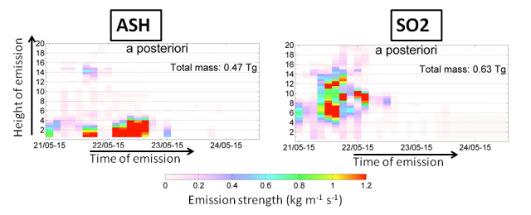
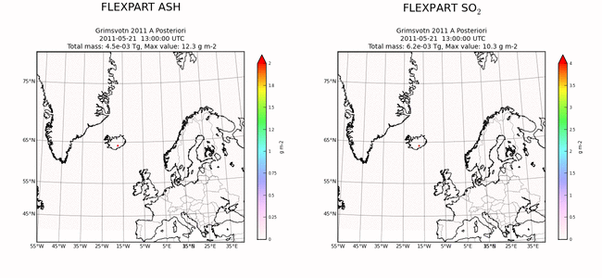
SO ATM - Volcanic ash applications
VAST
Source term “forensics”:
Ash /SO2 emission (vertical profile with time)
Forecast with the estimated ST
From N. I. Kristiansen, vast.nilu.no
Notes:
18
18

Slide 19
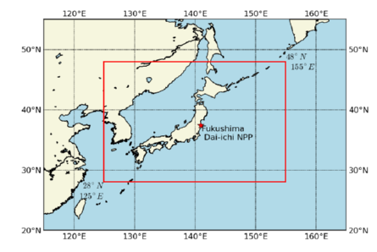
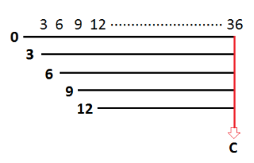
SO ATM - Nuclear applications SRS app.
Fukushima
Releases every 3-h from 11-31 March
168 simulations of duration of 72 h
601 by 401 grid cells
0.05° horizontal resolution (about 5 km)
3-h averaged air concentrations
3-hour deposition totals
Output layer: ground to 100 m
3 surrogate radionuclides
gas with no wet or dry scavenging (noble)
gas with a relatively large dry deposition velocity and wet removal (I-131)
particle with wet removal and a small dry deposition velocity
Cj,k,m = ∑ Qi,m Dm TCMi,j,k,m
Q is the emission rate for release (i) and species (m)
D is the species (m) dependent radioactive decay factor
i represents the number of time varying releases
j represents the number of sampling periods
Concentration and deposition are available over k grid points
with each new release (i), there will be one less output period (j)
Computations are made with a unit emission
TCM is computed for each computational species (scavenging dependent)
The emission (Q) and decay (D) are applied in a post-processing step
Notes:
19
19

Slide 20
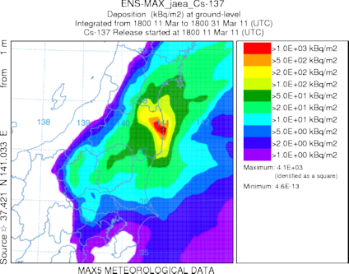
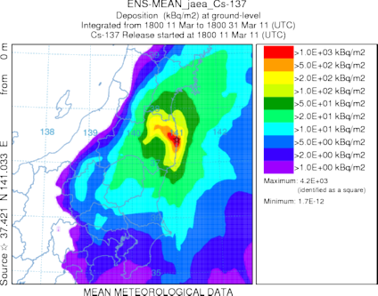
SO ATM - Nuclear applications
CMC’s MLDP0 - Modèle Lagrangien de Dispersion de Particules d’ordre 0
NOAA’s HYSPLIT - the Hybrid Single-Particle Lagrangian Integrated Trajectory
UKMET’s NAME - Numerical Atmospheric-dispersion Modelling Environment
JMA’s RATM - Regional Atmospheric Transport Model
ZAMG’s FLEXPART - Lagrangian Particle Dispersion Model
Ensemble 5
Ensemble 10
Notes:
20
20

Slide 21
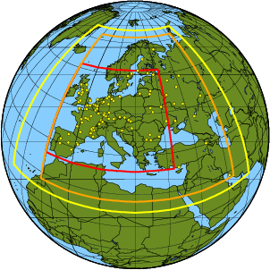
SO ATM - Applications
FLEXRISK
Flexrisk.boku.ac.at - flexible tools for assessment of nuclear risk in Europe
Database of European NPP with two information on type, start up and shutdown, safety measures, thermal power and accident and release frequencies. – grouped into similar characteristics
Definition of two release scenarios per type but analysis focused on one (plausible but with significant activity released)
Fwd ATM calculations (different times of year and day) for all the scenarios the 10-year-period 2000-2009 + 1995– climatological representativeness.
For selected radionuclides – calculation of dosimetric endpoints
Risk import-export
Notes:
21
21

Slide 22
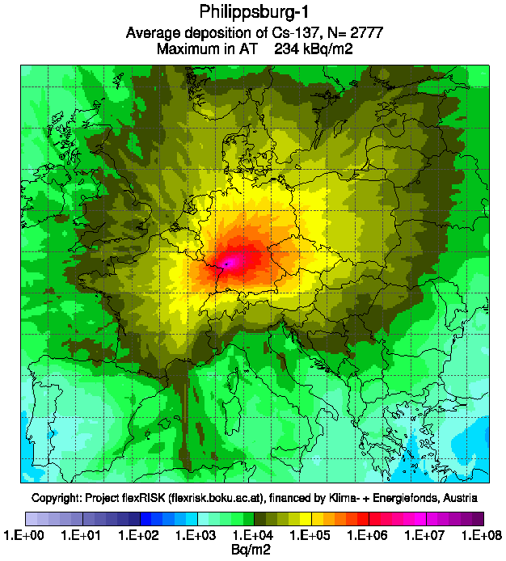
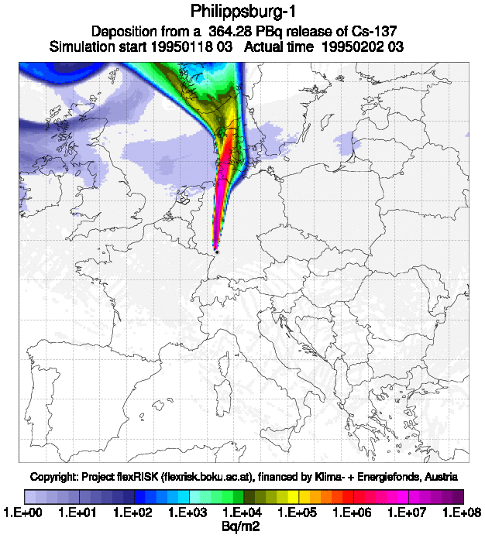
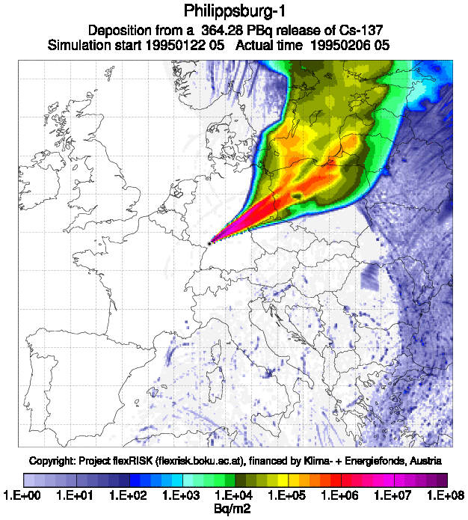
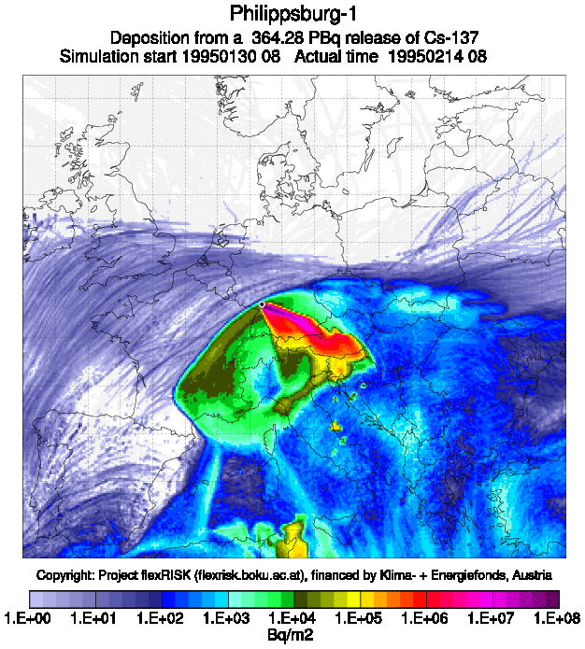
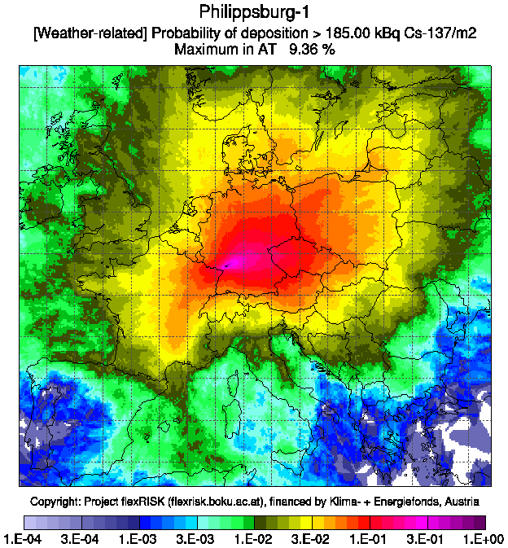
SO ATM - Applications
FLEXRISK - Philippsburg-1
Notes:
22
22

Slide 23
SO ATM - Applications
Advantages of this approach:
Multiple sources can be used since they are simply multiplied by the source receptor sensitivities
Additional runs can be easily added without having to redo the already existing ones
It can be operationally very efficient and fast.
Disadvantages of this approach:
Some a priori knowledge of the source is needed:
Location
Emission heights (release shape)
“Species” (aerosol, gas, noble gas)
Notes:
23
23

Slide 24

RO ATM – ideal example
Relation between measurement and emission? Very simple example: 1 point measurement, 1 D transport, 1 single emission at one single time and place
s6
- time
s1
s2
s3
s4
s5
Measurement: Y (Bq/m^3)
FLEXPART sensitivities: sx (s)
Emission flux: X Bq/m^2 s dilluted in a layer (m) --- (Bq/m^2 sm)
Y(to) = s1 X1(te1) + s2 X2(te2) + s3 X3(te3) + S4 X4(te4) + s5 X5(te5) + s6 X6(te6)
In this ideal case, only X5 is non-zero at time te5 →
Y(to) = s5 X5(te5)
Easy!!
Notes:
24
24

Slide 25
RO ATM – ideal example
s6
- time
s1
s2
s3
s4
s5
Is it the red or the blue emitting or both?
Y(to) = s5 X5(te5) + s6 X6(te6)
s6
- time
s1
s2
s3
s4
s5
s6 is now much larger than s5. This means that actually even if emission X6 is smaller, it will contribute more to the measurement!
Y(to) = s5 X5(te5) + s6 X6(te6)
Not so easy
Notes:
25
25

Slide 26
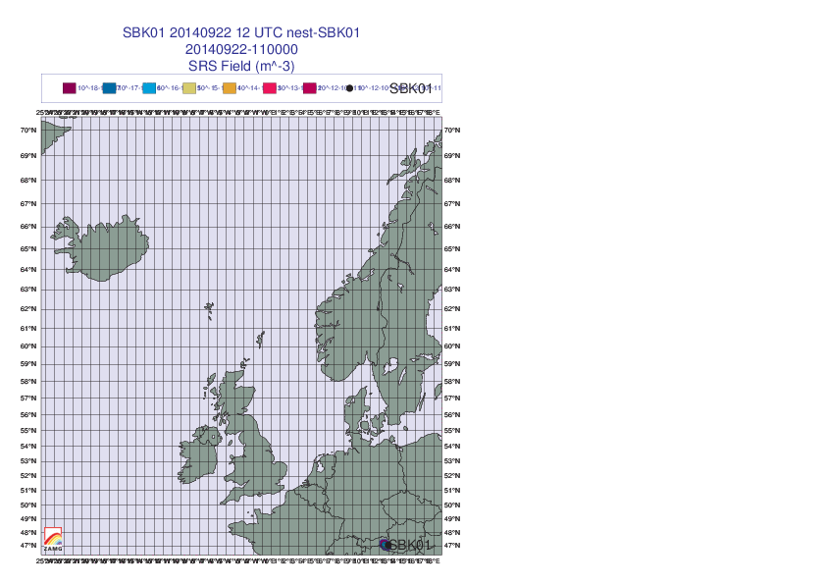
SO ATM - Volcanic ash applications
VAST
We do not have longh enough backtracking (therefore limitted SRS). The highest measurement in Sonnblick was of 250 ug/m3 and we assume that the SRS on the emission grid was in the order of 2x10**12 m-3, then we have a first guess of an emission (for that emission time) of 5x10**14 ug in one hour which means about 140 kg/s. http://en.vedur.is/earthquakes-and-volcanism/articles/nr/2947#sep18 suggests 200 -600 kg/s
Notes:
26
26

Slide 27
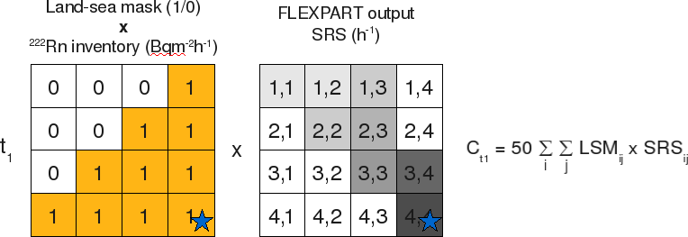
RO ATM – Radon time series
Let's try to understand the concept and application
Notes:
27
27

Slide 28
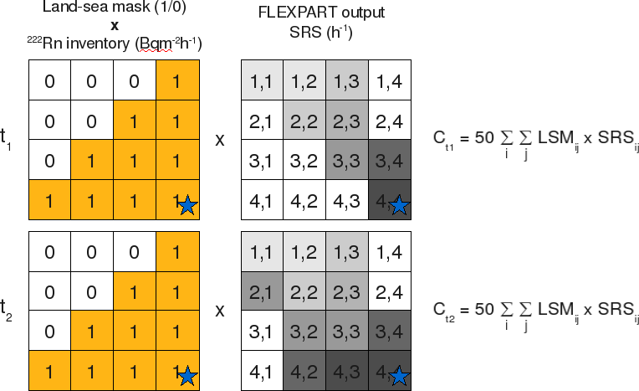
RO ATM – Radon time series
Let's try to understand the concept and application
Notes:
28
28

Slide 29
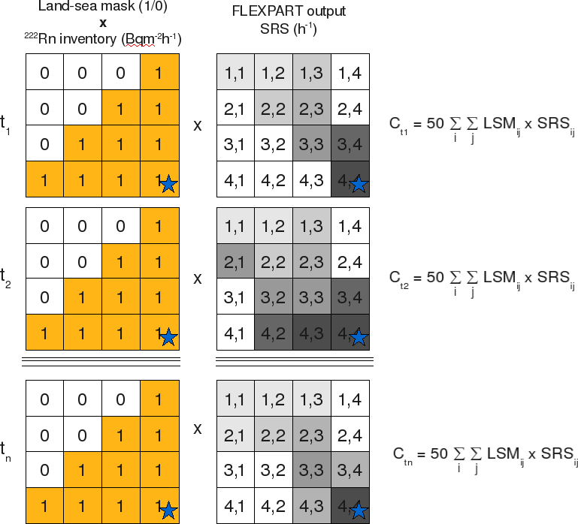
RO ATM – Radon time series
Let's try to understand the concept and application
Notes:
29
29

Slide 30
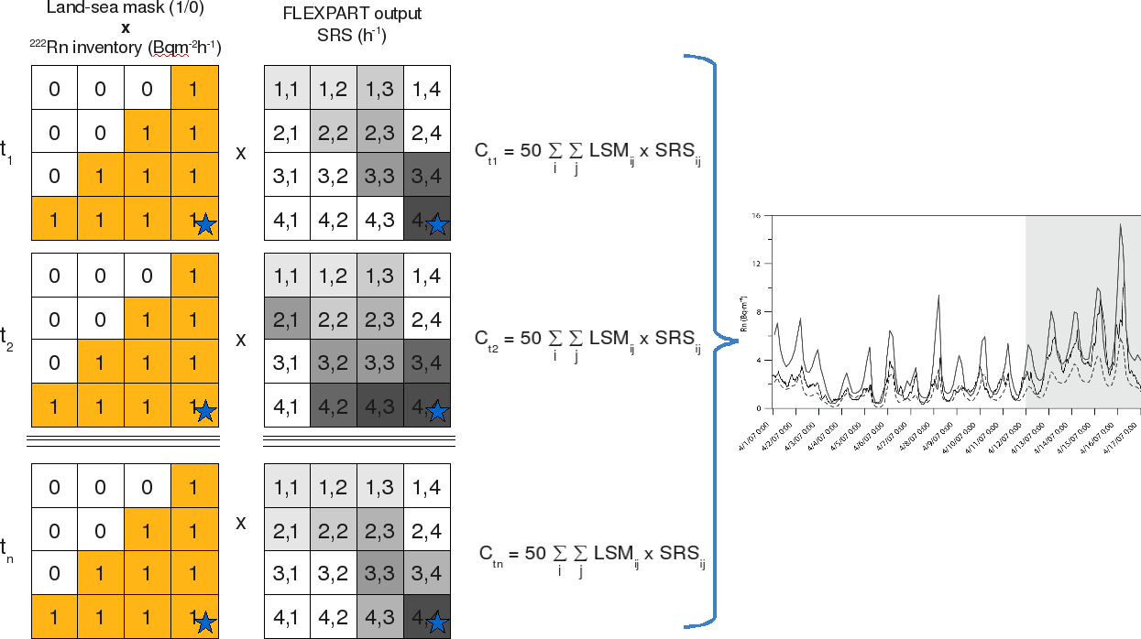
RO ATM – Radon time series
Let's try to understand the concept and application
Notes:
30
30

Slide 31
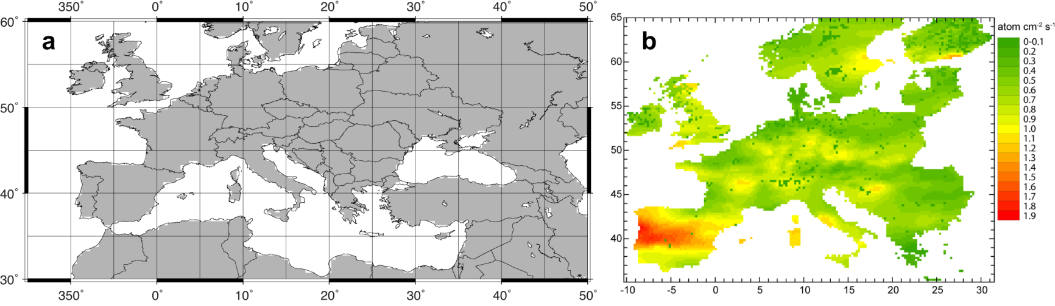
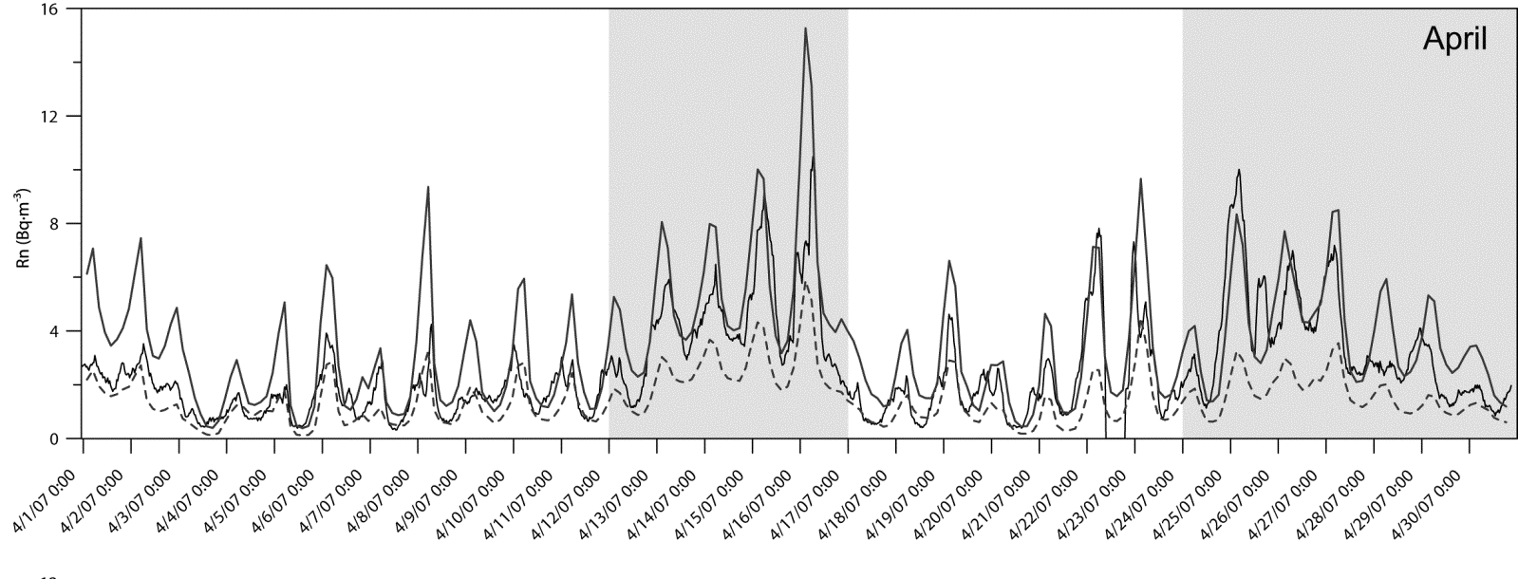
RO ATM – Radon time series
Example to reproduce the measurements of Rn in Cabaw (Arnold et al. 2009 Atm. Env.)
Notes:
31
31

Slide 32
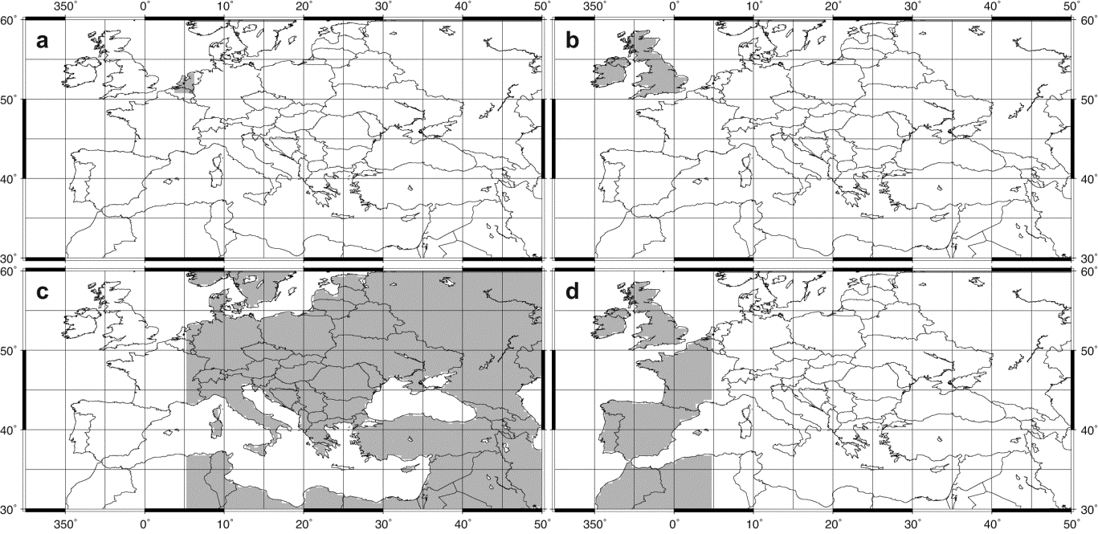
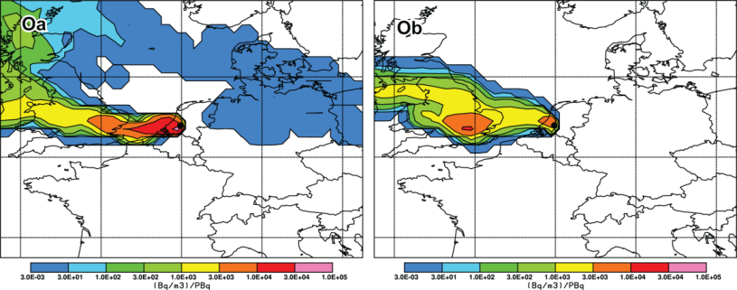
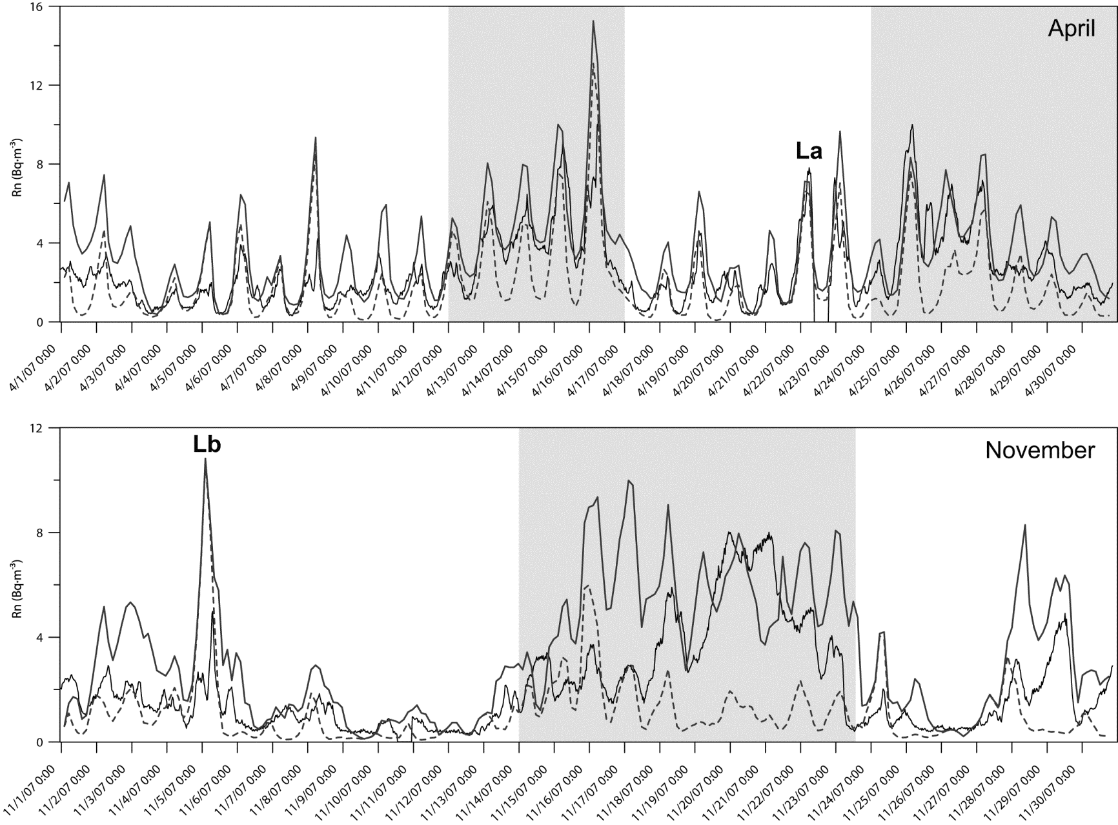
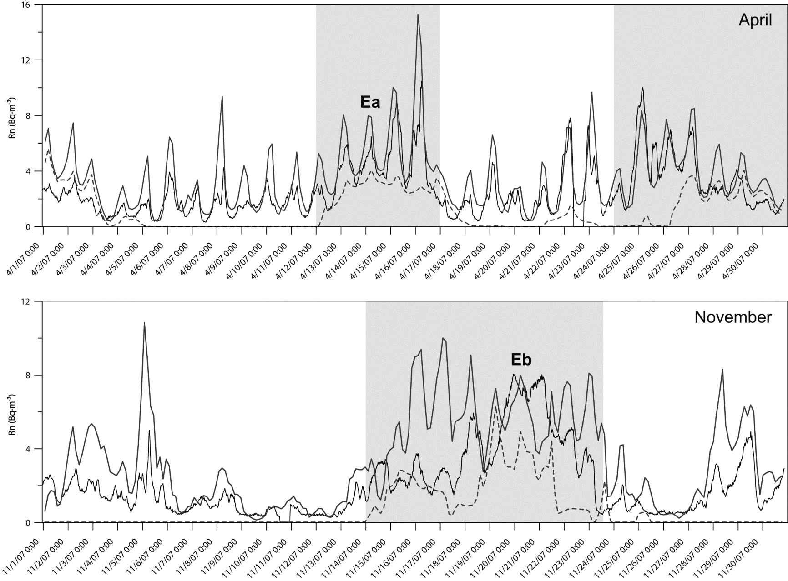
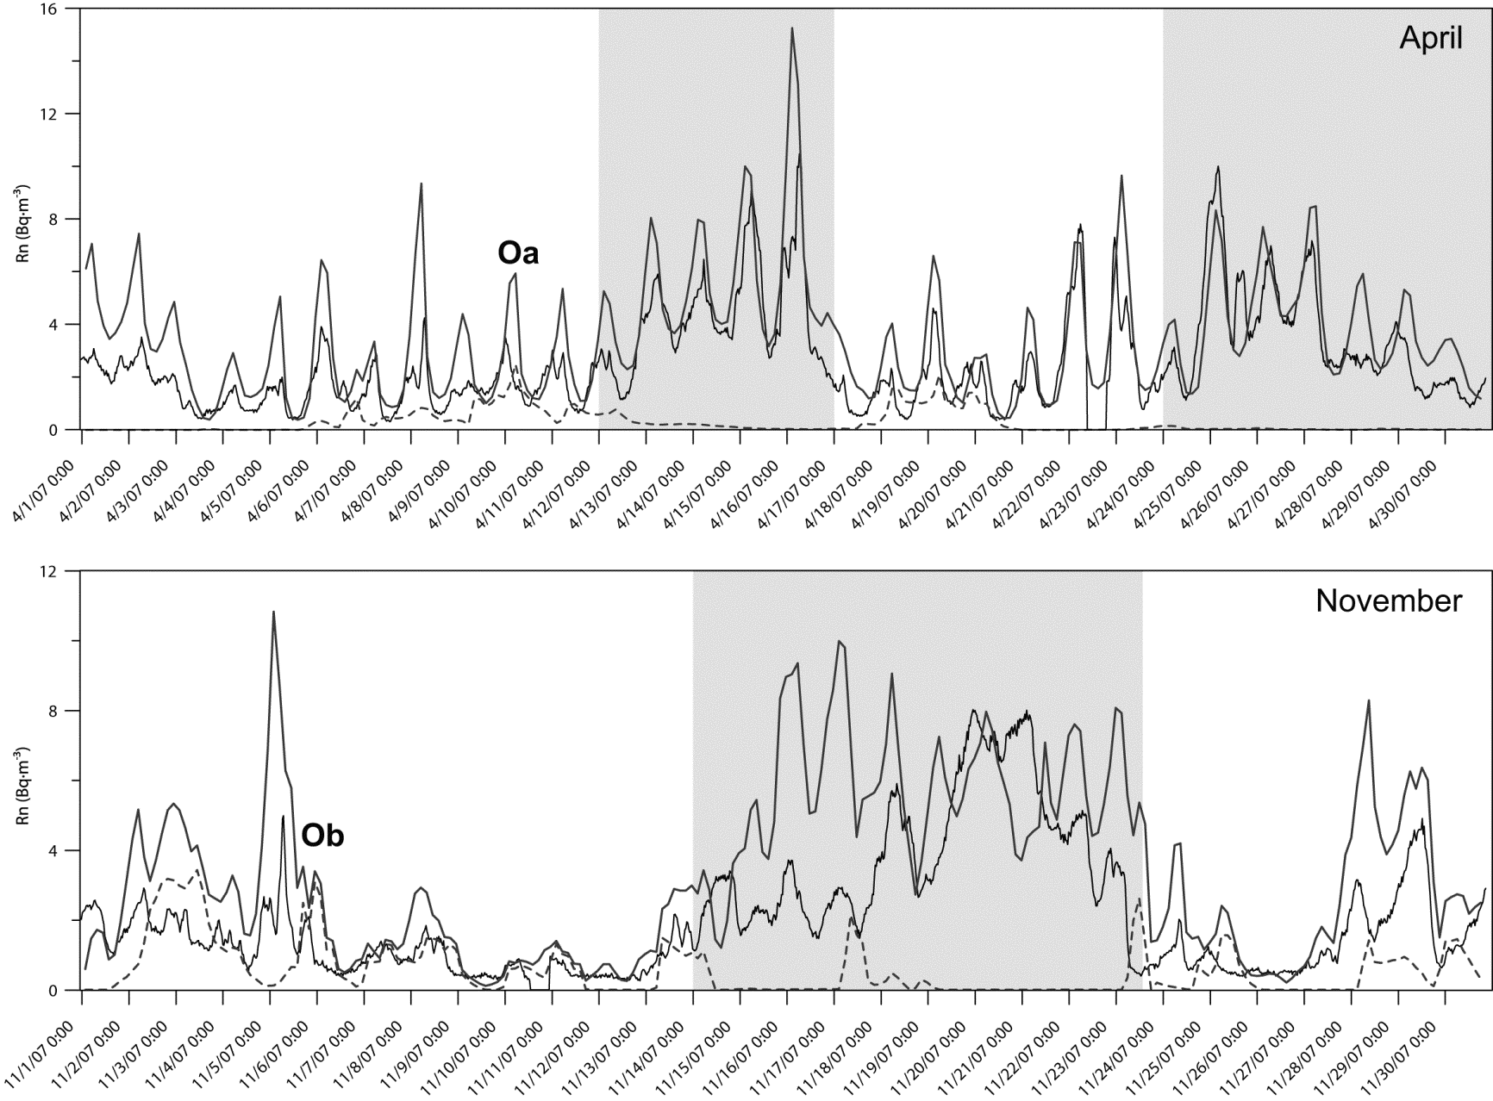
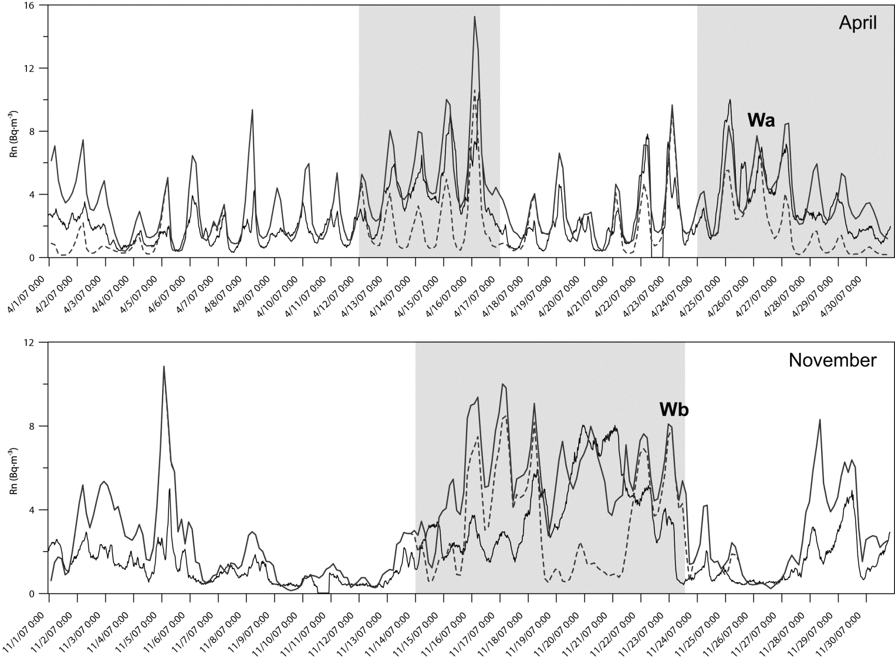
RO ATM – Radon time series
Example to reproduce the measurements of Rn in Cabaw (Arnold et al. 2009 Atm. Env.)
X
Notes:
32
32

Slide 33
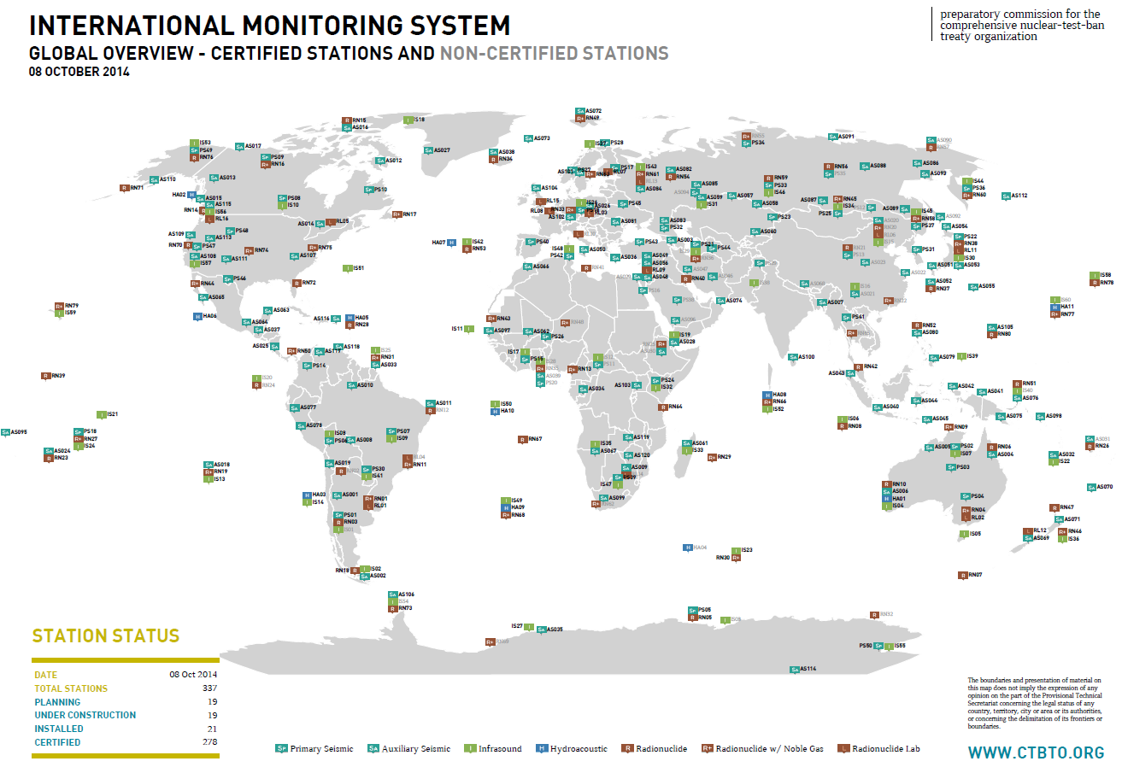
CTBTO – where/when nuclear test?
Notes:
33
33

Slide 34
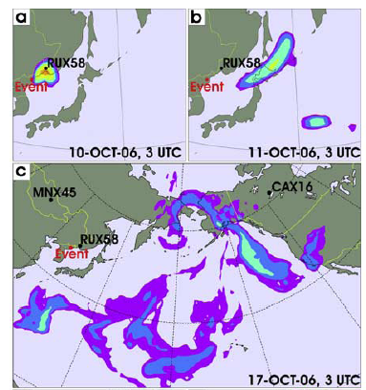
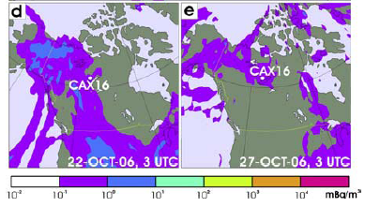
CTBTO – where/when nuclear test?
DPKR 2006
Calculations showed that radionuclides released immediately after the test would spread across Pacific towards the south and east, eventually reaching North America
Notes:
34
34

Slide 35
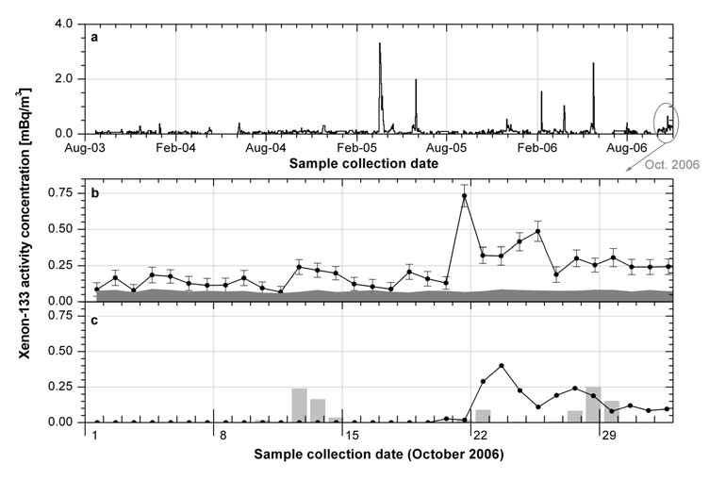
CTBTO – where/when nuclear test?
The FLEXPART simulation shows that ¹³³Xe detected in Yellowknife between 22 and 27 October 2006 may have originated from the DPRK event location
¹³³Xe observed 2003-2006
¹³³Xe observed October 2006
¹³³Xe predicted October 2006 (instantaneous release at REB location (boxes: Chalk River influence)
Notes:
35
35

Slide 36
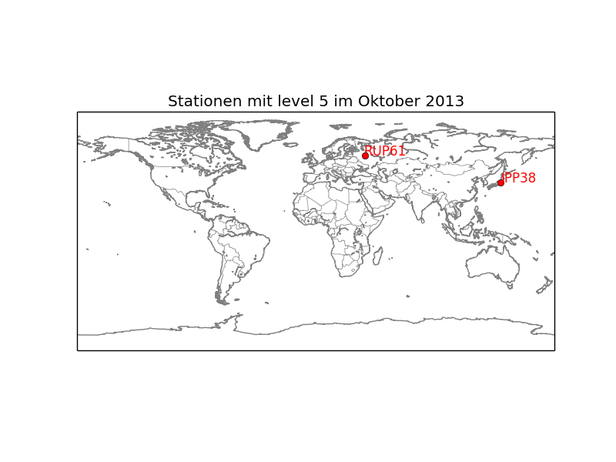
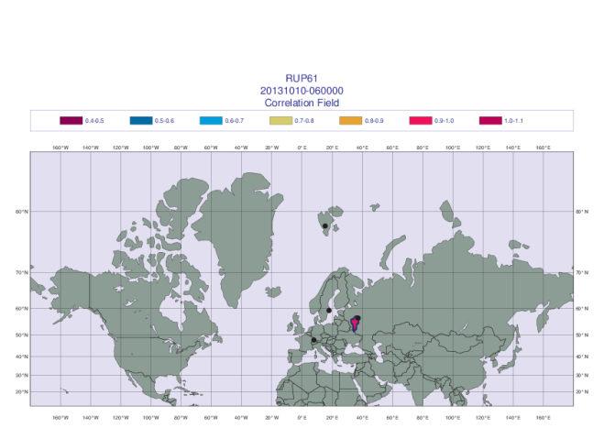



ZAMG – NDC
Calculation of the PSR (Possible source regions) fields for four days back in time for every radionuclide detected at (the) station(s) with (the) Level-5 event(s).
Notes:
36
36

Slide 37
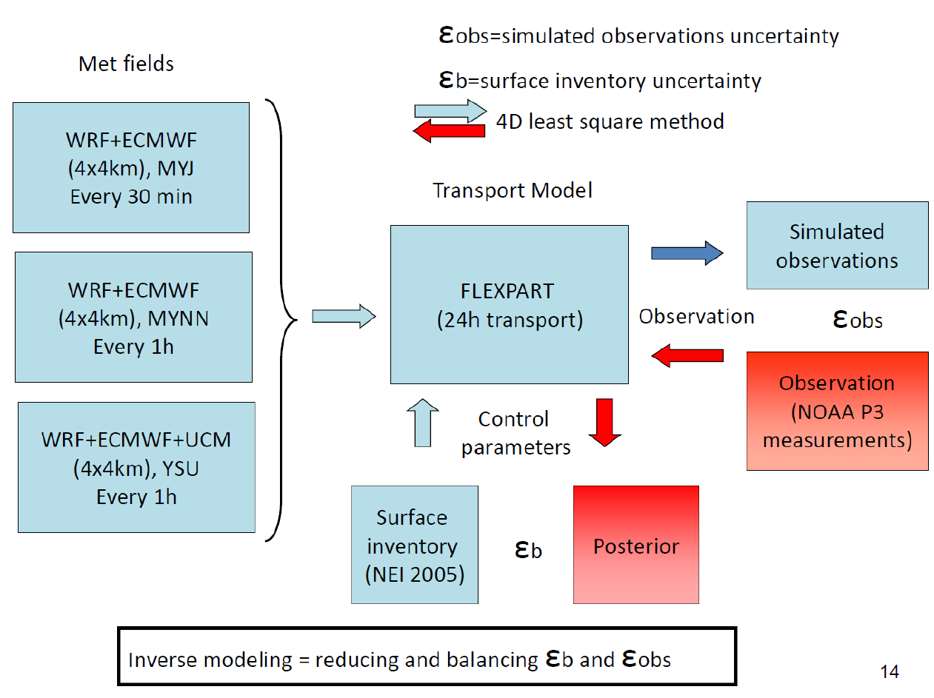
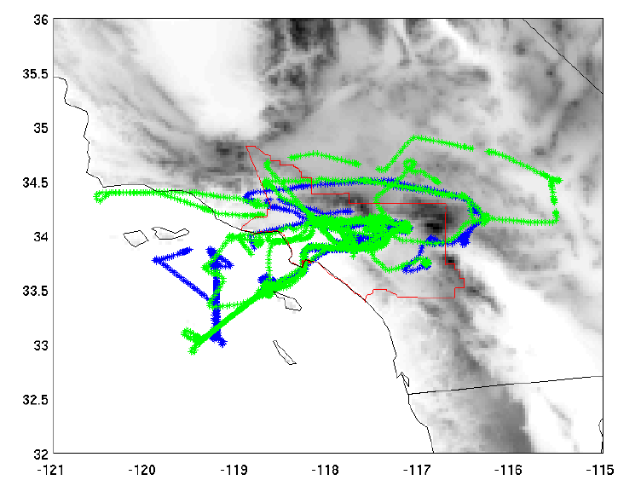
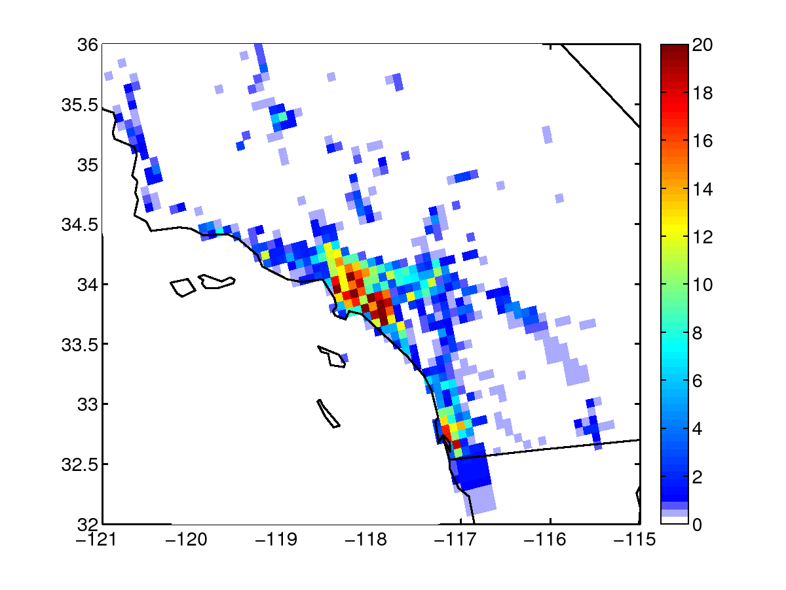
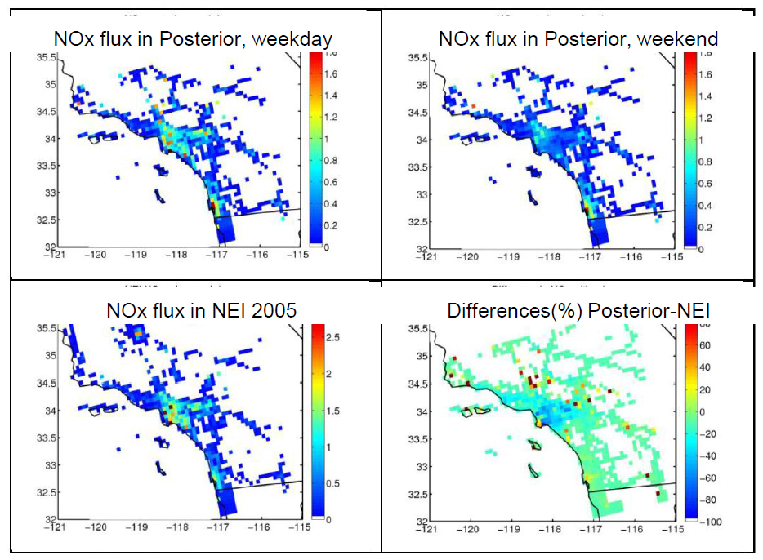
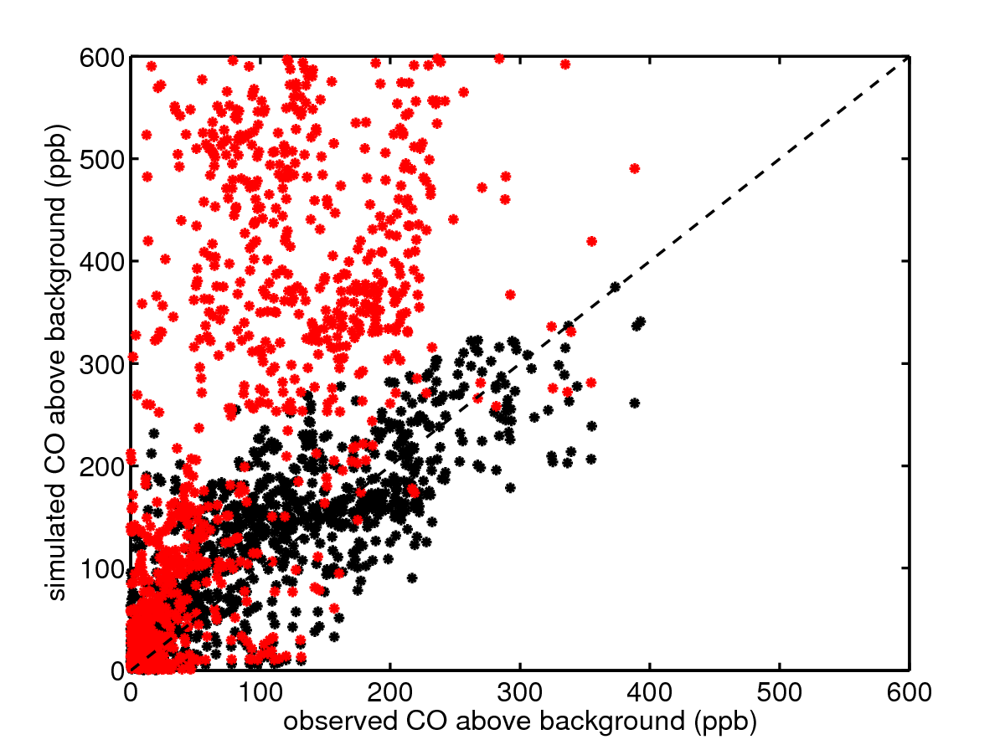
Emission inventories via inversion
Example of backtracking airplane measurements to obtain the model sensitivities for an inversion of surface fluxes of CO, NOx and CO2 (Brioude et al. 2013) courtesy of Jerome Brioude
6 flights during CALNEX 2010 used to evaluate LA basin anthropogenic emissions
3 flights during weekdays, 3 flights during weekends
flux in NEI 2005
- Using NEI
- Using Posterior
Notes:
37
37

Slide 38
Remarks
Backtracking is very useful and computationally very efficient (consider doing fwd runs from all the potential source locations, strengths and times to understand ONE single measurement at one time!). Usually constrains in the information are needed to narrow down possibilities, for example point emission, time of emission, a priori estimate of the emission, data fusion with independent data sources (i.e., seismic, infrasound…)
Notes:
38
38

Slide 39
Model uncertainties
Let’s have a look at some of the uncertainties involved in the modelling procedure:
Source term (nuclear, gridded inventory, volcanic emission…)
Estimated ambient concentrations/deposition downwind - SRS fields…
Atmospheric transport model
Meteorological driving data/models (NWP)
Notes:
39
39

Slide 40
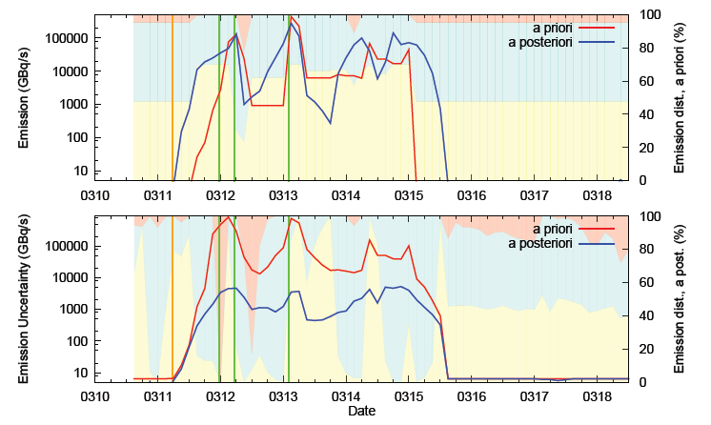
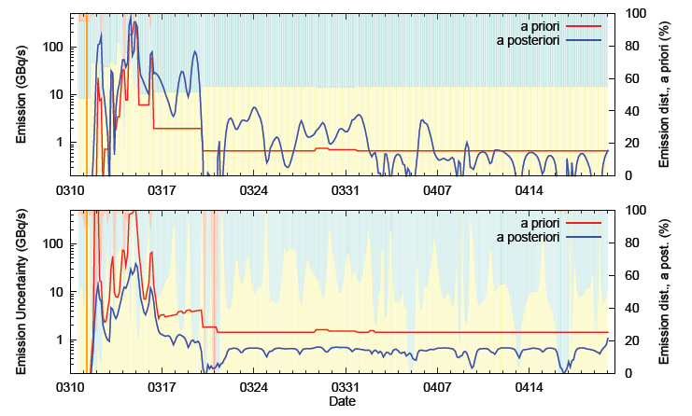
Model uncertainties
Source term:
Nuclear accident: known location, uncertain emission time, strength, release shape and radionuclide mixture.
Volcanic emissions: known location, known (under some circumstances) emission time, uncertain emission height, strength, time evolution, ash particle size distribution (volcano dependent).
Anthropogenic emission inventories (bottom-up, top down) relying on relatively sparse measurements (errors on the observations), on state members information, …
Notes:
40
40

Slide 41


Model uncertainties
Meteorological driving data (analysis or forecasts) – errors in wind fields are the most important since they largely define the transport patterns:
Forecast errors
Wilks (2006)
For analyses:
Inaccuracy of meteorological measurements
limited data coverage in some regions of the globe
analysis schemes
Precipitation errors due to parameterizations involved, often lack of analysis of precipitation and also due to the often sub-grid variability of the precipitation
http://old.ecmwf.int/products/changes/ifs_cycle_38r1/soil_reanalysis_impact.html
Notes:
41
41

Slide 42
Model uncertainties
Dispersion models:
Parameterization errors:
Vertical and horizontal turbulent mixing. Parameterisations are based on analytical relationships often derived in idealised conditions (for example: relatively flat and homogeneous terrain)
Dry / Wet deposition. Specially convection, which is subgrid in the horizontal and grid-scale in the vertical and which strongly affects the distribution of particles (for LPDM) in vertical but also horizontal due to the updraft-downdrafts systems
Numerical errors:
Eulerian models – discretization of the equations and specially important the advection schemes (numerical diffusion and phase errors), narrow plumes purely represented
Puff models – very stretched puffs in non-homogeneous conditions
Lagrangian particle dispersion models – errors associated to particle number, low statistics and discretisation
Interpolation errors – all models require interpolation of the fields to either the computational grid/integration time step or the output grid/integration-output time step.
Notes:
42
42

Slide 43
Model uncertainties
How to asses and quantify these uncertainties?
Model intercomparisons
Who is rigth?
Controlled experiments (CAPTEX, ETEX, …):
Limited meteorological situations
Limited species (tracers, non deposition…)
Data often collected only at surface stations (limited vertical information)
Tracers of opportunity (Fukushima, Algeciras, Chernobyl, ANSTO, Eyja, …):
Limited knowledge of the source term and therefore an additional important source of uncertainty unknown
Error propagation /error incorporation along all the processes – not straight forward since each independent uncertainty is already difficult to identify and quantify and because ATM alone have already quite important algorithms.
It is good to identify/understand (pdf?) the main sources of uncertainty, characteristics of the errors and focus on them
Notes:
43
43

Slide 44

Model intercomparisons
Model intercomparisons are very useful (depending on set-up: same source? Same driving data? …) BUT the question of “who is right?” will always appear unless good and independent observational data is available
Call for model intercomparison after the Fukushima Dai-ichi modelling studies:
Notes:
44
44

Slide 45



Model intercomparisons
ZAMG Fukushima TT work (see G. Wotawa‘s presentation) – variation of resolution of input data with the same JAEA source term:
Notes:
45
45

Slide 46





Model intercomparisons
ZAMG Fukushima TT work (see G. Wotawa‘s presentation) – variation of type of input data (ECMWF – NCEP) with the same JAEA source term
ZAMG Fukushima TT work (see G. Wotawa‘s presentation) – influence of mesoscale precipitation information – only 0.2 deg resolution shown (NWP, mesoscale models, radar rain gauge information)
Notes:
46
46

Slide 47


Model intercomparisons
Volcanic ash transport model intercomparisons – VATMIS (led by D. Morton, UAF, Borealscicomp.com). Unified model intercomparison for volcanic ash transport modelling by Don Morton, Dèlia Arnold Dèlia Arnold, Peter Webley, Gerhard Wotawa, Barbara Stunder (soon published in International Journal of Air Polluttion)
SO₂ total column concentration (kg m⁻³). FLEXPART, HYSPLIT and PUFF

Slide 48
Some thoughts on evaluation/verification
Atmospheric transport studies often rely on observational data (e.g. inverse modelling studies). Verification can only be properly made with independent observational data.
Point to grid comparisons (goodness according to co-location and strength) may become problematic for small grid cells.
Verification with controlled experiments can only be made with the scales and species characteristics the experiments were thought for.
Some natural traces may be as well useful for model evaluation. Traditionally, radon has been used as tracer for a wide range of scales (careful with radon flux variations though)
How to choose the metrics? There is not real rule of thumb. A combined rank can be an option and the scientist may define what to weight or penalize more.
Notes:
48
48

